Slide 1
Introduction to Children's Oral Health and Community Dentistry
Brent Lin, DMD
Clinical Professor, Division of Pediatric Dentistry
University of California, San Francisco

Slide 2
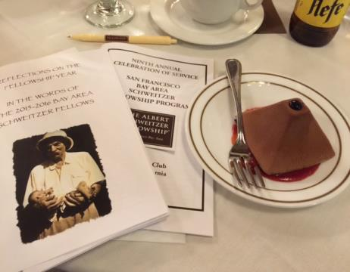
The purpose of human life is to serve and show compassion and the will to help others.
- Albert Schweitzer -

Slide 3
Acknowledgment
HRSA Award No: D85HP28498-01-02
Pre-Doctoral Training in General, Pediatric, Public Health Dentistry, and Dental Hygiene

Slide 4
Purpose of this Course
Increase workforce in the underserved communities
Primary care providers in medicine, nursing, and dentistry
Dental hygienists
Serve as a platform for community networking and promote partnership with other healthcare providers
Increased pipeline of workforce in the underserved communities
Notes:
When we designed our project, what we have in mind are what are the needs in community, and not what we want to accomplish for our group. Other healthcare workers involved because they are more likely to see children at an early age than us dentists. And the best time to shape the behavior and life long experience of dental health is between the age of 1 – 1 ½ years. In another word, let’s get everyone involved!!!

Slide 5
Project Goals
Prepare primary trainees and other healthcare trainees for oral health care of children in the underserved communities, as well as the vulnerable and special needs children.
Promote and enhance the collaborative and interprofessional effort by healthcare providers in delivering effective preventive and/or primary oral health care for children

Slide 6
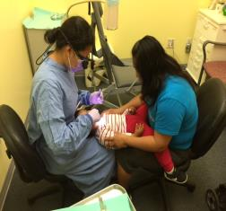
Pediatric Dentistry Curriculum
Chabot College Course “Advanced Topics in Dental Hygiene”
Target trainees: Dental Hygiene Students
Highlights:
Annual course for 10 didactic sessions,
simulated session, clinical experience,
and community outreach experience.
Faculty from UCSF
Notes:
What can be better to train them before they become a doctor? Let’s integrate this practice and ingrained oral health before they start the very first day of their professional career or practice.

Slide 7
Pediatric Dentistry in “Advanced Topics in Dental Hygiene”
Course Requirements:
Ten didactic sessions
At least one session of clinical participation at UCSF
At least one session of community outreach program
Participation of pre- and post- assessment evaluations
Participation of annual post-training survey for 5 years

Slide 8
Schedule
1. Title: Introduction to Children's Oral Health and Community Dentistry
Instructor(s): Dr. Brent Lin
Thursday, August 25, 2016 11:00 AM - 12:00 PM
2. Title: Physical Assessment of Oral Cavity and Recognition of Abnormalities
Instructor(s): Dr. Ray Stewart
Thursday, September 22, 2016 11:00 AM - 12:00 PM
3. Title: Anticipatory Guidance in Pediatric Dentistry
Instructor(s): Dr. Karen Duderstadt
Thursday, October 27, 2016 11:00 AM - 12:00 PM
4. Title: Pediatric Caries Risk Assessment and Disease Prevention
Instructor(s): Dr. Ray Stewart
*Thursday, November 17, 2016 11:00 AM - 12:00 PM
5. Title: Infant Oral Health Care, Dental Home, and Referral
Instructor(s): Dr. Ray Stewart
**Thursday, December 8, 2016 11:00 AM - 12:00 PM

Slide 9
Schedule
6. Title: Pediatric Restorative Dentistry and Dental Radiograph
Instructor(s): Dr. Jackie Nguyen
***Thursday, January 26, 2017 11:00 AM - 12:30 PM (Typodont Simulation Exercise)
7. Title: Pediatric Behavior Management, Nitrous Oxide, and Local Anesthesia
Instructor(s): Dr. Jackie Nguyen
Thursday, February 23, 2017 11:00 AM - 12:00 PM
8. Title: Trauma and Space Management on Primary Dentition
Instructor(s): Dr. Jackie Nguyen
*Thursday, March 16, 2017 11:00 AM - 12:00 PM
9. Title: The Effect of Cultural and Linguistic Competency and Health Literacy on Access to Children's Oral Health Care
Instructor(s): Dr. Linda Centore
Thursday, April 27, 2017 11:00 AM - 12:00 PM
10. Title: Case Presentations
Instructor(s): Dr. Brent Lin and all course instructors
*Thursday, May 18, 2017 11:00 AM - 12:00 PM

Slide 10
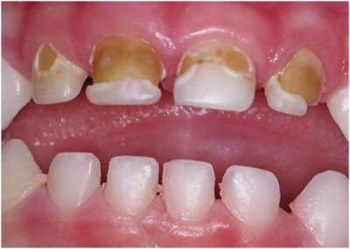
Facts about Dental Caries in Children
Dental caries is a preventable disease
Among children in San Francisco Unified School District, approximately ___% of the students experienced dental decay in their primary dentition by the time that they enter kindergarten.
Notes:
Dental caries is a preventive disease. Yet it is the most common chronic disease in children. It is truly a behavior disease (not brushing, ignore daily oral hygiene, frequent snacking, etc.)

Slide 11
Facts about Dental Caries in Children
Dental caries is a preventable disease
Among children in San Francisco Unified School District, approximately 35% of the students experienced dental decay in their primary dentition by the time that they enter kindergarten.
Notes:
Dental caries is a preventive disease. Yet it is the most common chronic disease in children. It is truly a behavior disease (not brushing, ignore daily oral hygiene, frequent snacking, etc.)

Slide 12
Early Childhood Caries (ECC)
The presence of 1 or more decayed (noncavitated or cavitated lesions), missing (due to caries), or filled tooth surfaces in any primary tooth in a child 71 months of age or younger

Slide 13
Kindergarten Children in San Francisco with Untreated Caries SFDPH Child Care Health Project and SFUSD
 | 2000 | 2008
Higher Income Schools (0-24% of Children Eligible for the National School Lunch Program) | 9% | 5%
Lower Income Schools (75%+ of Children Eligible for the National School Lunch Program) | 26% | 40%

Slide 14
Annual Household Income Relative to the Federal Poverty Level 2014 California Children’s Report Card childrennow.org

Slide 15
Kindergarten Children in San Francisco with Untreated Caries between 2012-2013 San Francisco Kindergarten Dental Screening Project Data Collected by SFDPH, SF Dental Society, National Dental Association, and SFUSD

Slide 16
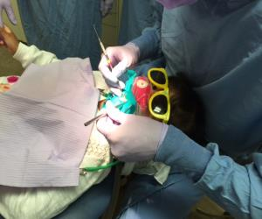
Oral Health Disparity among Children
Approximately 80% of dental disease
occurred in 20-25% of children
Why?
Geographic, cultural, and economic barriers
Difficulty in care access due to lack of resources, oral healthcare providers, and dentists participating in the state welfare program
Unpreparedness and fear of dentists working with infant and very young children

Slide 17
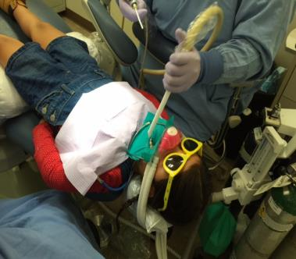
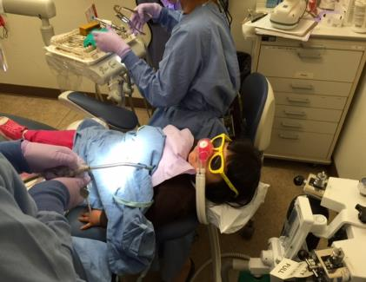
The Consequences
Notes:
And so we see tons of caries and treatment in children. In fact, all these children are seeing in the Native American Health Center on this Thursday morning. All of them have severe early childhood caries and required a lot of work. We also see three children in the operating room at the Children’s Hospital one block from here yesterday. They are 2, 3, and 3, years of age, and the first child is Hispanic American, the second one is African American, and the third one is Chinese or Cantonese American. They all required extensive work. In fact, two out of 3 children have dental caries on every single tooth. One of them, we need to place 17 stainless steel crowns, two baby root canals, and 3 tooth extractions. BUT All of these can be prevented if the dental diseases are recognized and identified early, the child is timely referred to a specialist, and early intervention is done.

Slide 18
The Consequences

Slide 19
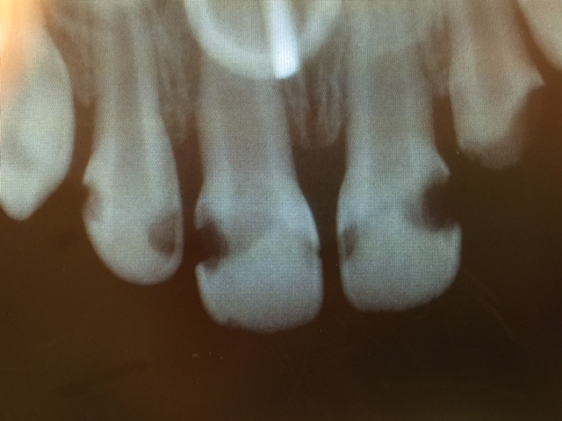

Slide 20
Severe Early Childhood Caries (S-ECC)
In children younger than 3 years
of age, any sign of smooth-surface caries.
From ages 3 through 5, 1 or more cavitated, missing (due to caries), or filled smooth surfaces in primary maxillary anterior teeth or a decayed, missing, or filled score of ≥4 (age 3), ≥5 (age 4), or ≥6 (age 5) surfaces.

Slide 22
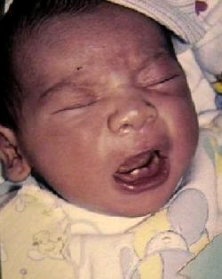
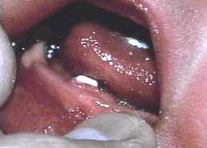
Infant Oral Health Exam
AAPD Guidelines: An initial oral evaluation visit should occur within 6 months of eruption of the first primary tooth and no later than 12 months of age.
Risk Assessment
Anticipatory Guidance
Developmental milestones

Slide 23
Anticipatory Guidance
Speech and language development
Intraoral/perioral piercing
Substance abuse
Fluoride adequacy or excess
Dietary Habits
Nonnutritive Habits
Injury prevention / trauma
Oral hygiene
Oral development

Slide 24
Children’s Oral Health for All Health Care Providers (5 minutes)
Chief Dental Complaint
Dental History
Dental Screening Examination
Caries Risks Assessment
Anticipatory Guidance
Dental hygiene Instruction (give away toothbrush and floss) and dietary consult
If needed, topical fluoride application and referral for timely intervention

Slide 25
Children’s Oral Health for All Health Care Providers (5 minutes)
Chief Dental Complaint (form)
Dental History (form)
Caries Risks Assessment (form)
Dental Screening Examination (trained provider)
Anticipatory Guidance (trained provider)
Dental hygiene Instruction and dietary consult (assistant or print out instruction)
If needed, topical fluoride application and/or referral for timely intervention (trained provider)

Slide 26
Dental Screening Examination
Light source
Tongue blade / dental mouth mirror
Gauze (2x2 or 4x4)
Toothbrush
Topical fluoride varnish

Slide 27
Patient’s position for Dental Screening Examination
Knee to knee exam or lap to lap exam
Supine position on examination bed
Sitting on examination bed (with or without assistant)
If needed for fearful patients, standing or sitting on regular chair

Slide 28
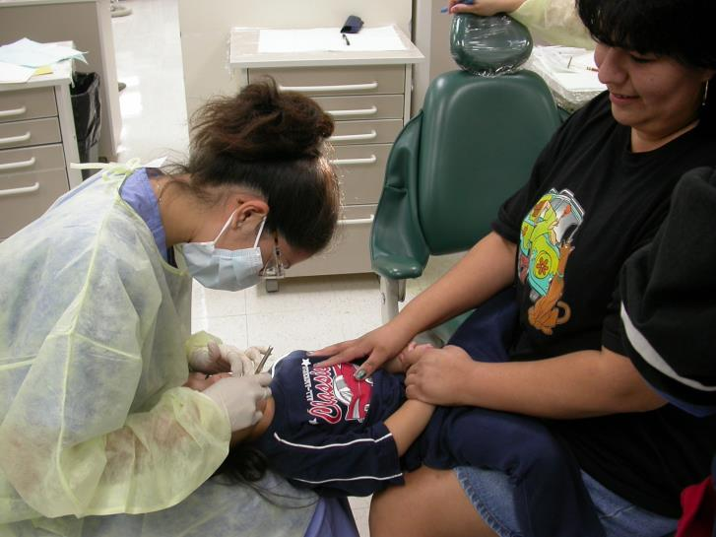

Slide 29
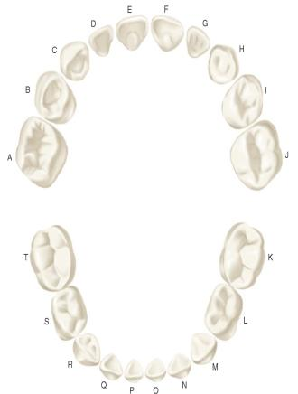
Components of the Primary (Deciduous) Dentition (20 teeth)
4 Central Incisors
4 Lateral Incisors
4 Cuspids (Canines)
8 Molars

Slide 30
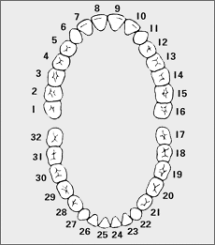
Components of the Permanent (Succedaneous) Dentition (32 teeth)
4 Central Incisors
4 Lateral Incisors
4 Cuspids (Canines)
8 Bicuspids (Premolars)
12 Molars

Slide 31
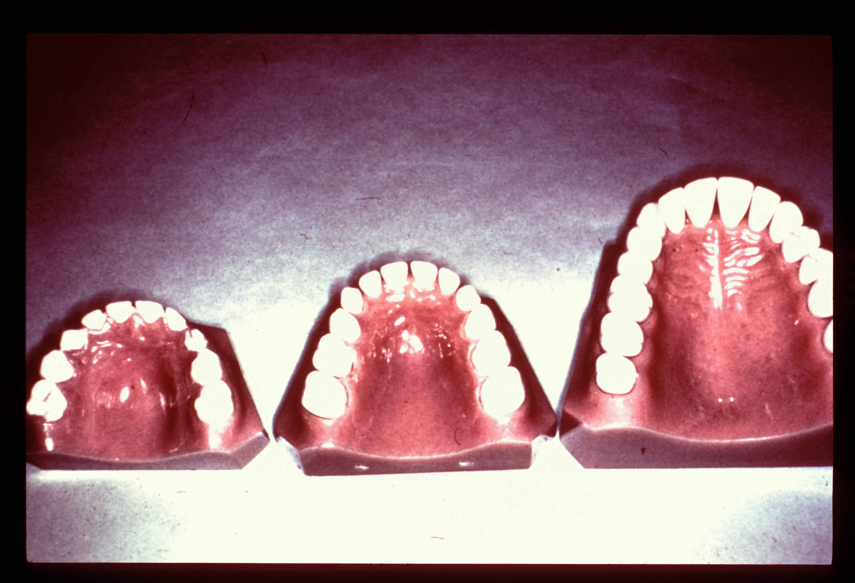
Primary dentition – 6 months to 6 years Mixed dentition – 6 years to 11 years Permanent dentition – 11.5 years onwards

Slide 32
Tooth Eruption
6 months – First primary tooth
3 years – Complete primary tooth eruption
6 years – Permanent lower incisors and permanent first molars
6-12 years – Mixed dentition
12 years – Permanent second molars

Slide 33
Essential to remember
All dates are merely approximate guidelines.
There is a wide variation of normal in either direction.
So, always be ready to reassure the worried parent as to why his/her child’s teeth are late!

Slide 34
Eruption Sequences
Primary Dentition – Max. and Mand.
Central incisor, lateral incisor, first molar, canine, second molar
Permanent Dentition – Max.
First molar, central incisor, lateral incisor, first premolar, second premolar, canine, second molar, third molar
Permanent Dentition – Mand.
First molar, central incisor, lateral incisor, canine, first premolar, second premolar, second molar, third molar

Slide 35
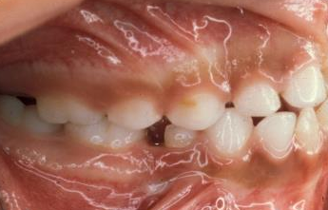

Slide 37
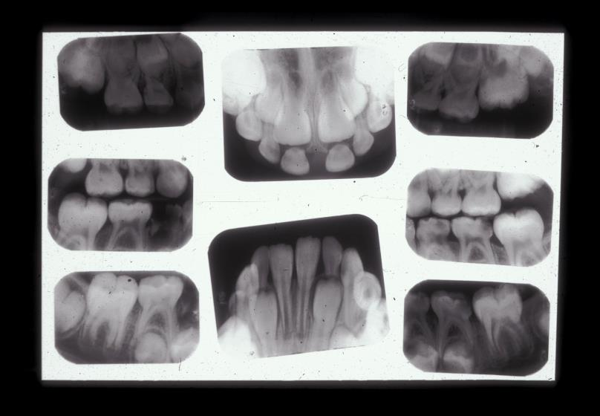

Slide 38
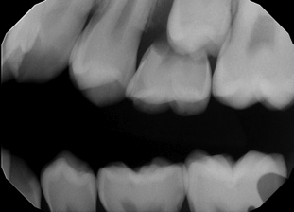
Case Review – Treatment Plan

Slide 40
Functions of the primary teeth
Maintain space for permanent successors
Stimulate growth of jaws through mastication
Facilitate correct mastication of food
Assist in proper speech development
Facial esthetics

Slide 41
Differences between Pediatric and Adult Assessment
Physical, Emotional, and Psychological Differences
Behavior as an Integral Part in Children Assessment
Preventive Care vs. Rehabilitative Process
Dentist-Parent-Patient Relationship
Children are in a Constant State of Changes

Slide 42
Age 0-3
Emotions undiscerned
Behavior changes – crying
Separation anxiety
Second year – language skills
Third year – NO, Why

Slide 43
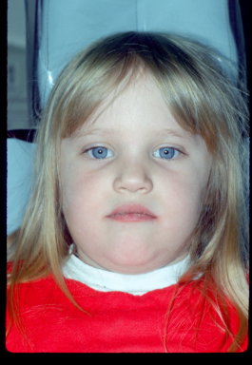
Preschool 3-6
Developing
Process of self control
Frustrations
Fears
Power of Reasoning
Attention Span
3 year old: 4-8 minutes
4 year old: 8-12 minutes
5 year old: 12-28 minutes

Slide 44
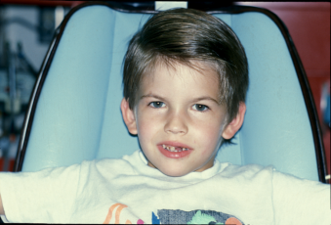
School Age 6-12
Literate
Body image / establish self-identity
Ability of independence
Influence of peers in school

Slide 45
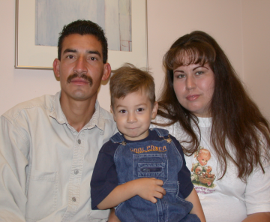
Patient Assessment
Demographic Information
Base Line Data
Weight, Height, Vital Signs
Chief Complaint and History of Present Illness
The History
Medical, Family, Social, Dietary, and Oral
Clinical Examination
General Appraisal, Systemic, Extra-Oral, and Intra-Oral
Radiographic Examination
Behavior

Slide 46
Vital signs

Slide 47
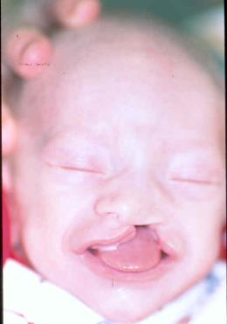
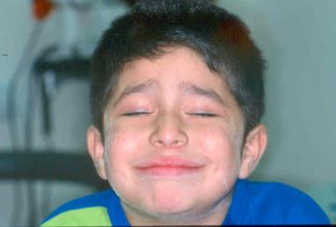
Clinical Examination

Slide 48
Profile

Slide 49
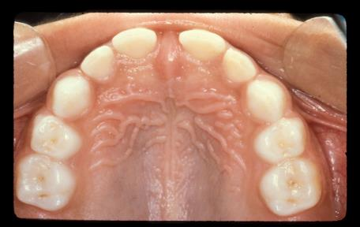
Occlusal Evaluation
Arch Form
Symmetry
Spacing
Crowding
Presence or absence of teeth

Slide 50
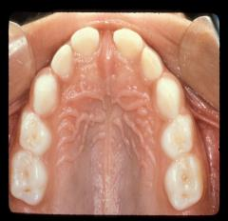
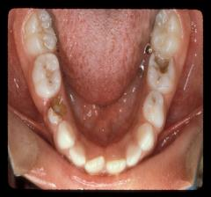
Primate space
Between maxillary lateral incisor and canine
Between mandibular canine and first molar
Developmental space
Spacing between the remaining teeth
Leeway space
The space difference between primary canine + molars and permanent canine + premolars

Slide 51
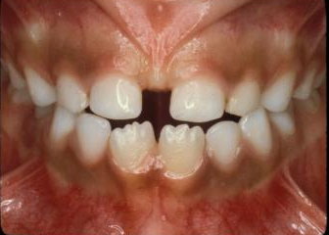
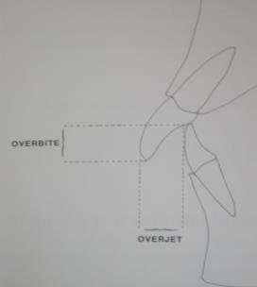
Transverse Relationship
Midline discrepancies
Posterior crossbite
Vertical Relationship
Overbite: vertical overlap
Described in percentage or mm
Overjet
Horizontal overlap
2 mm in the primary dentition

Slide 52
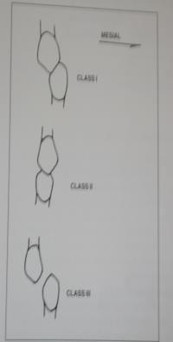
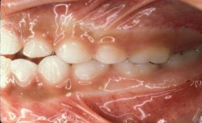
Molar and Canine Relationship

Slide 53
Diagnosis
Pediatric diagnosis is dynamic
Collect data, analyze information, and formulate diagnosis and problem list
Examples of proper diagnosis:
Early childhood caries
Gingivitis
Right posterior crossbite

Slide 54
TREATMENT PLANNING
Address Medical Concerns
Prophylactic Antibiotics, latex allergies
MD consult
Parent/Guardian consent, court order
Preventive, Restorative, and/or Surgical needs
Address urgent care / chief complaint
Quadrant dentistry
Consideration of exfoliating primary teeth
Orthodontic considerations
Space maintenance plan
Orthodontic referral

Slide 55
TREATMENT PLANNING
Behavior management assessment and plan
Tell-Show-Do, desensitization, modeling, positive reinforcement, voice control
N20/O2, oral sedation, general anesthesia
Medical Immobilization / Restraint
Appropriate maintenance care
Home care needs assessment, Fluoride rinse, supplements
Periodic Oral Evaluation (“Recall”) Plan
Presenting Treatment Plan to Parents

Slide 57
Progress Note Format (PHDcTEN)
Problem (P) Indicate procedure(s) to be done on that appointment or
purpose/reason for the visit, including chief complaint.
History (HX) Note and review significant medical, oral, social, family, and dietary histories; contraindications to routine dental care.
Diagnosis (DX) Clinical and radiographic diagnoses of patient's overall oral
condition for patient's evaluation visit. Clinical and radiographic
diagnosis of the oral / dental condition that required treatment for
patient's treatment visit.
Caries Risk Classification of "high", "moderate", and "low" based on caries
Assessment (CRA) risk assessment guidelines. This section only
applies to the patient evaluation visit (NPE or POE).
Treatment (TX) Details of treatment/services provided. Drugs/medication used
must be recorded. Documentation for use of sedation or medical
immobilization also need. Must included the time of application/
administration and duration of time immobilization is utilized.
Notation of informed consent obtained. Tooth number & surface
involved and crown sizes must be recorded.
Evaluation (E) Assess and describe behavior at each visit. Notation of how
patient tolerated the procedure. Give useful hint on behavior
management for next visit.
Next Visit (NV) Plans for next visit, referral if needed, reminder before next visit

Slide 58
Example of Progress Note
P: 3y/o Female for first dental visit (NPE)
H: ASA II, Asthma, Meds: Albuterol prn, NDKA, thumb sucking habit
D: dental caries, gingivitis, right posterior crossbite
CRA: high
T: exam, 2 BW’s, 2 PA’s, Prophylaxis with fluoride prophy paste, topic fluoride application, anticipatory guidance reviewed with parents, oral hygiene care instruction given, consent form obtained.
E: moderately anxious; TSD is helpful; recommend N2O/O2
N: operative on teeth A and B with N2O/O2.

Slide 59
UCSF Oral Health Alliance
Created to be inclusive
Website: http://oralhealth.ucsf.edu/
Simple design and user friendly
Our Team
Opportunities to collaborate

Slide 60
Notes:
Remember, you may be the first dentist that the child sees, and so you have the opportunity to shape their dental experience for life.

Slide 61
Notes:
It is your responsibility to guide them to good oral health. If you did it appropriately, you can practice true disease prevention and create a beautiful smile for these children.

Slide 62
THANK YOU!
Questions?

